Slide 1

DEPARTMENT OF ECONOMICS ESTD 1992
FACULTY OF SOCIAL SCIENCE
MAHARSHI DAYANAND SARASWATI UNIVERSITY, AJMER

Slide 2


The Department endeavours to impart specialized knowledge in the field of Economics to enable the students to become agents of change in the social and economic development of the country.
The Department foresees and creates platform for their active participation in the development of society.

Slide 3

Mission
Provide opportunities to the students in the sector of Economic welfare and development by including skills, analytical aptitude and scientific approach
Enabling students to solve the economic and social problems of present era.

Slide 4


Strategies
Course curriculum and pedagogy take into consideration the vision of the Department challenging students with assignments and internal evaluation
Developing attitude for Research

Slide 5

COURSES OFFERED 2021-22
M.A. Economics
01
Ph.D
02

Slide 6
MA Economics (Choice Based Credit System)
Teaching and Learning as inquiry
MA Economics (Annual)
48 credits of core courses, 24 disciplinary elective courses, Foundation courses allow interdisciplinary choice as well
Options
Industrial Economics
Mathematical Economics
Demography
Health Economics
Agricultural Economics
Financial Institutions & Financial Management
History of Economic Thought & Indian Thinkers
Environmental Economics
LEARN
Seminars
Dissertation/
Project Work
CREATE
SHARE

Slide 7

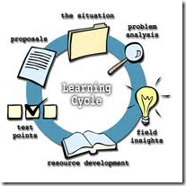
Online classes during pandemic
Library hours
Student seminars
Smart board
Power point presentations
Industrial visit in first semester
project in fourth semester
Traditional chalk-board

Slide 8
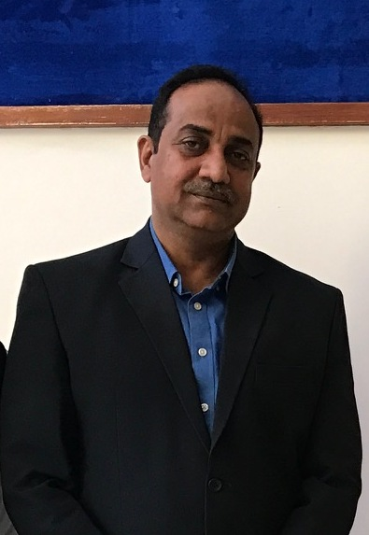
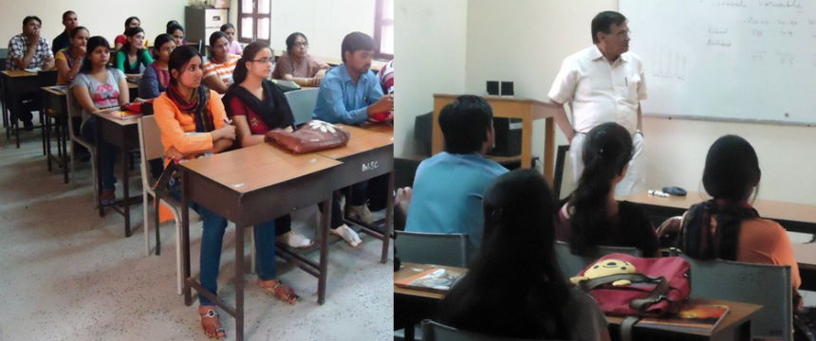
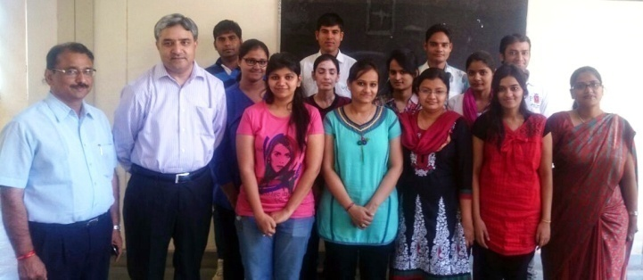
CROSSOVER LEARNING
Industrial visit
Participation in student seminars, workshops, training
Field work
Kautilya series of Lectures

Slide 9
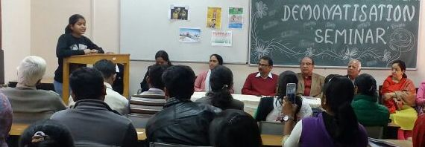
TECHNICAL WRITING AND PRESENTATION SKILLS
Wall Magzine
Seminars
Reports

Slide 10
Name of the Programme | Applications received | Selected |  | Pass percentage
 |  | Male | Female | Male | Female
MA (Economics) | 195 | 79 | 98 | 19 | 81
M.B.A. (Bus. Eco) | 80 | 46 | 35 | 37 | 63

Slide 11
Facilities
Library 525 books, National News Papers 04; Journals and Reports
Internet facilities for staff and students: Available
Total number of class rooms: Two
Class rooms with ICT facility: One
Students’ laboratories: One Computer Laboratory

Slide 12
FINANCIAL ASSISTANCE TO STUDENTS
Professional Faculty Fund Scholarship
One each in M.A. Previous and Final

Slide 13
The Department of Economics 2021
Professor & Head: Dr. Shiv Dayal Singh
GUEST FACULTY
3 (1 retired Principal, 1PhD and 1 UGC NET JRF)
Post Doctoral Fellow
Dr. Vikas Yadav
LDC- Mr. Vishal Shrivastav
CLASS IV – Mr. Gulab Singh

Slide 14
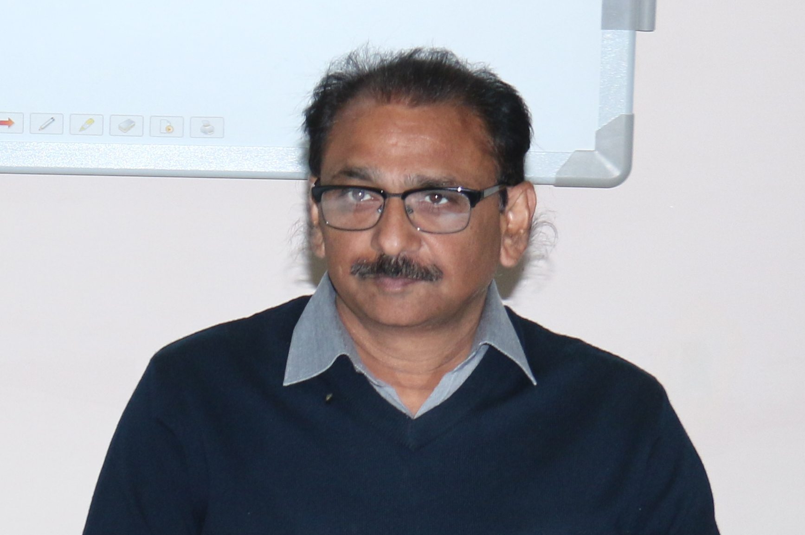
PERMANENT FACULTY
Name | Qualification | Designation | Specialization | No. of Years of Experience | No. of Ph.D./ M.Phil. students guided
Shiv Dayal Singh | Ph.D. & M.A. Economics | Professor | Development Economics, Demography | 26 | 1 PDF mentored 2 PhD awarded 5 PhD continuing 13 MPhil awarded

Slide 15
M.A. Economics
Session | Applications Received | Students admitted | Male | Female | Appeared in Final Year Examination | I | II
 |  | Total | Male | Female | Total | I Div | II Div
2016-17 | 24 | 20 | 13 | 07 | 07 | 1 | 0
2017-18 | 36 | 18 | 08 | 10 | 13 | 3 | 0
2018-19 | 31 | 20 | 05 | 15 | 08 | 2 | 2
2019-20 | 23 | 14 | 05 | 09 | 11 | 3 | 6
2020-21 | 19 | 09 | 01 | 08 | - | - | -

Slide 16
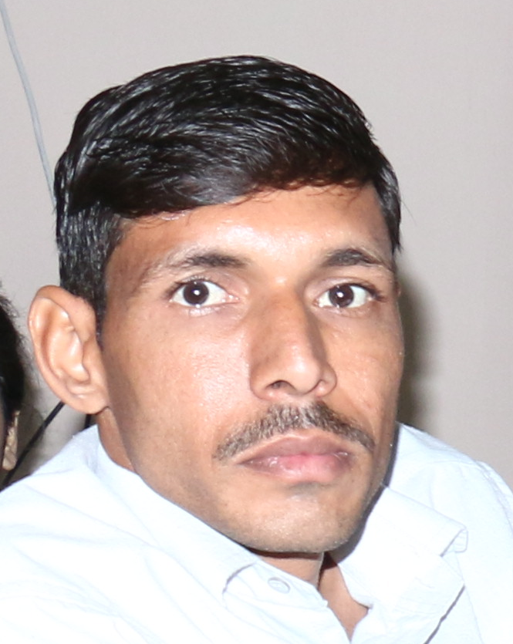
Post Doctoral Project
“A Comparative Study of Socio-Economic Development of BIMARU States in India” PI: Dr. Vikas Yadav, Mentor: Dr.Shiv Dayal Singh Rs. 16.74 lakh from 16.11.15 to 15.11.18

Slide 17
Research
PhD
NAME | Date of Registration | TITLE
Manasvi Singh Tanwar | 11.12.2019 | Patterns and Sustainability of Economic Growth of Rajasthan
Khsuhbu Chaudhary | 19.7.2016 | An Analytical Study of State Government Programs for Primary Education with Special reference to Ajmer District
Sumitra Devi Sahu | 23.6.2018 | An Empirical Analysis of Linder Hypothesis with respect to India and its Trading Partners
Dheeraj Kumar Pareek | 23.6.2018 | ‘Ekaatm Arth chintan” of Deen Dayal Upadhyay with reference to Indian Economic Policy and Challenges
Monica Shrivastav | 19.7.2016 | A Comparative Study of Mauryan Period Economy and Modern Economy

Slide 18
PUBLICATIONS
Khushbu Chaudhary & Shiv Dayal Singh (2021) An Analytical Study of Primary Education in Ajmer District of Rajasthan SHODH SANCHAR Vol.11(41), pp 46-49 ISSN – 2229-3620
Dheeraj Kumar Parekh and Shiv Dayal Singh (2021) Bhaarteeytaa se yukt arthashaastree: Pandit Deen Dayal Upadhyay. Shodh Sarita 8(29): 110-113. ISSN 2348 2397.
Vikas Yadav & Shiv Dayal Singh (2020) Role of BIMARU States in India’s Population Policy Goal of Population Stabilization SHODH SARITA Vol.7(28), pp.73-79 ISSN – 2348-2394
Shiv Dayal Singh and Dheeraj Kumar Parekh (2020) Bharteey sanskriti evam ekaatm arth chintan. Drishtikon. 12(6):1220-22. ISSN 0975119X
Shiv Dayal Singh & Khushbu Chaudhary (2018) An Analytical Study of District-Wise Status of Women Empowerment in Uttar Pradesh. AJANTA part –II Vol. VII (II), PP.51-58 ISSN – 2277-5730
Khushbu Chaudhary & Shiv Dayal Singh (2018) An Analysis of Socio-Economic Status of Government School Pupils with Mid Day Meal in Ajmer District of Rajasthan AJANTA part-vi Vol. VII (III), PP. 123-129 ISSN -2277-5730
Pushpa Chauhan & Shiv Dayal Singh (2016) The Development and Present Status of SEZ in Rajasthan. Asian Research Consortium Vol.6, No.3, pp.79-89 ISSN 22497307
Shiv Dayal Singh, Anant Phagna & Gulraj Kohli (2014),”Public Distribution System in Rajasthan”, International Journal of Food, Nutrition and Dietetics 2(2):53-56 2322-0775

Slide 19
PUBLICATIONS
Vijay Veer Singh , Shiv Dayal Singh (2013),” Sampling Procedure & Design”, In : Research Methodology : A Compendium (Eds.) Tapan Choure. Aksharvinyas, Ujjain. Pg. 11-24 978-81-928133-0-1
Shiv Dayal Singh (2013), “Rising Women participation in MGNREGS : A case Study of Rajasthan.” The IIS University Journal of social Science 2(1) : 16-26. 2319-2593
Shiv Prasad, Shiv Dayal Singh & Veena Kumari (2013), “An Empirical Study of Emerging Dimensions of Tourism in India”. South Asian Journal of Tourism & Heritage 6 (1): 145-158 . 0974-5432
Shiv Prasad, Shiv Dayal Singh & Veena Kumari (2013), “Balance Score Card : A way to implement strategy in turbulent times ( A case Study of R.K. Marbles)”, Indian Journal of Applied Research 3(5): 33-35 2249-555X
Abhinav K. Raina, Shiv Dayal Singh & Naveen Kumar Sharma (2012), “Empowerment, Contextual Performance and Job Satisfaction : An Empirical Assessment of Hospitality Industry in Rajasthan”, South Asian Journal of Tourism & Heritage 5 (2): 99-123 ISBN 0974-5432
Namita S. Moyal, Gulraj Kalsi Kohli & Shiv Dayal Singh (2012), “Socio demographic characteristics of the elderly males 960-80 years) affects their health and nutritional status” Asian Journal of Home Science 7(2):556-563 0973-4732

Slide 20
PUBLICATIONS (contd....)
Shiv Dayal Singh, Anant Phagna ( 2012), “Service Sector- The Engine of Growth” In: The Impact of globalisation on Economic, Political and socio-cultural domains in India’Dr. Anant Bhatnagar and Dr Sudha Agarwal (eds). RVVSP Shramjeevi college, Ajmer .pg 80-85 8189431-40-4
Shashi Singha , Shiv Dayal Singh(2012),”Role of CRM in E-retailing in India” In: Retailing in India only Business or Beyond Prof. Barbara Cangan and Elvin T. Cangan (eds). Excel India Publisher, New Delhi 978-93-82062-96-7
Shiv Dayal Singh (1997) Economic Development and Ecological Balance. Chintan- A Research Journal of Maharshi Dayanand Saraswati University, Ajmer
Shiv Dayal Singh (1996) Urban Water Supply : The Case of Ajmer City In: Urban Water Management Edited by M.S.Rathore , V. Ratna Reddy Rawat Publications Jaipur and New Delhi ISBN 81-7033-302-3
Shiv Dayal Singh and Mahendra Sharma (1992) Silvi-Pastoral Activities for Sustainable Development. Yojna Vol. 36; No. 3
Shiv Dayal Singh (1990) Urban Fuel Demand and Environment Yojna Vol. 34, No. 5

Slide 21
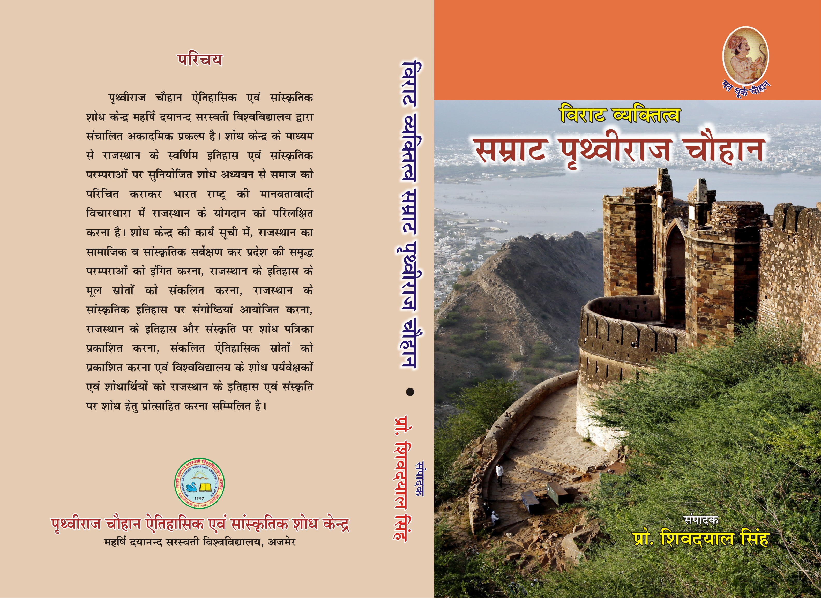
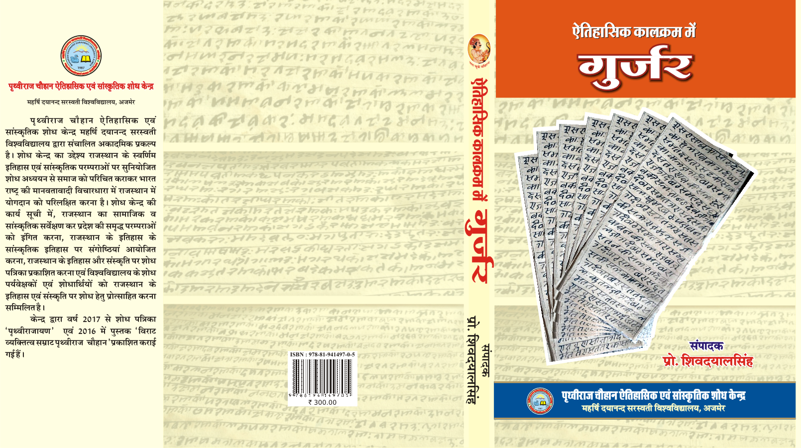
BOOKS & JOURNALS
विराट व्यक्तित्व: सम्राट पृथ्वीराज चौहान
ऐतिहासिक कालक्रम में गुर्जर
JOURNAL
PRITHVIRAJAYAN: AN INTERDISCIPLINARY JOURNAL

Slide 22
Communications in Seminars/Conferences
41

Slide 23

SOCIAL INTERPHASE

Slide 24
DISTINGUISHED ALUMNI
Name | Address | Designation
Dr. Hemlata Manglani | Department of Economics Central University of Rajasthan, Kishangarh (Ajmer) | Assistant Professor
Dr. Anurag Asawa | Department of Economics GoKhale Institute of Politics and Economics | Assistant Professor
Dr.Surender Kumar 9460804264 | Department of Economics VMOU, Kota | Assistant Professor
Ranveer Singh | Statistical and Planning Department, Jaipur | Joint Director
Name | Address | Designation
Anil Kumar Verma 9928378412 | Reserve Bank of India, Mumbai | Research Officer, Grade B
Svatantra Kumar | Bank P.O. | Bank P.O.
Parbhudayal Jangid | Bank P.O. | Bank P.O.
Yogender | Savitri Girls Government College, Ajmer | College Lecturer
Dharm Singh Meena 9001163666 | College Lecturer JBD Government Girls College, Kota | College Lecturer

Slide 25
STRENGTHS
Well equipped computer lab
Departmental Library
Innovative teaching approach
Educational trips

Slide 26
WEAKNESSES
Insufficient faculty
Campus placements lacking

Slide 27
FUTURE
THE BEST ‘B’ SCHOOL
CBCS
APPOINTMENTS
CAMPUS PLACEMENTS
FULFIL INDUSTRIAL DEMAND

Slide 28
THANKS

